Slide 2
Course Overview
Day 1: Introduction to ML, Model Building, Text Processing, Bag of Words (BoW), and K Nearest Neighbors Model (KNN)
Day 2: Tree-based Models, Regression Models, Optimization, Regularization, Hyperparameter Tuning, and AWS AI/ML Services
Day 3: Neural Networks, Word Embeddings, Recurrent Neural Networks (RNN), and Transformers
Day 4: Tabular Data, AutoML, Image Classification, Convolutional Neural Networks (CNN), and Transfer Learning

Slide 3
Topics for Day 2
Tree-based Models
Regression Models
Optimization
Regularization
Hyperparameter Tuning
AWS AI/ML Services and Model Deployment
Final Project

Slide 4
Topics for Day 2
Tree-based Models
Regression Models
Optimization
Regularization
Hyperparameter Tuning
AWS AI/ML Services and Model Deployment
Final Project

Slide 5
Decision Trees
Decision Trees are flowchart-like structures that can be used for classification or regression tasks.
Root Node:
It is the start node
Internal Node:
It has exactly one incoming node and two or more outgoing edges.
It has attribute conditions to separate records.
Leaf or Terminal Node:
It has exactly one incoming edge and no outgoing edges.
It is assigned a class label (for classification).
R
I1
L1
L2
I2
L3
L4
L5

Slide 6
Decision Trees – Numerical Example
x₁ | x₂ | y
3.5 | 2 | 1
5 | 1.5 | 2
1 | 3 | 1
2 | 4 | 1
4 | 2 | 1
6 | 6 | 2
2 | 9 | 2
4 | 9 | 2
5 | 4 | 1
3 | 8 | 2
Given this dataset, let’s predict the y class (1 vs. 2) using a decision tree.

Slide 7
Decision Trees – Numerical Example
Class 1
Class 2
x₁ | x₂ | y
3.5 | 2 | 1
5 | 1.5 | 2
1 | 3 | 1
2 | 4 | 1
4 | 2 | 1
6 | 6 | 2
2 | 9 | 2
4 | 9 | 2
5 | 4 | 1
3 | 8 | 2
x₂
9
8
7
6
5
4
3
2
1
1 2 3 4 5 6
x₁

Slide 8
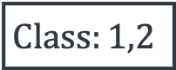
Decision Trees – Numerical Example
What feature (x₁ or x₂) to split by, to best separate class 1 from class 2?
Class 1
Class 2
x₂
$$Class:1,2$$
9
8
7
6
5
4
3
2
1
1 2 3 4 5 6
x₁

Slide 9
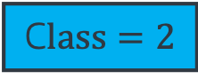
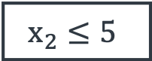

Decision Trees – Numerical Example
Class 1
Class 2
x₂
$$x_{2}≤5$$
Yes
No
9
8
7
6
5
4
3
2
1
$Class:1, 2$
C$lass=2$
5
1 2 3 4 5 6
x₁

Slide 10
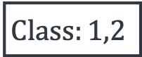
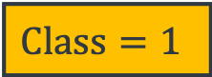
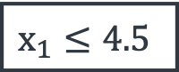
Decision Trees – Numerical Example
Class 1
Class 2
x₂
$$x_{2}≤5$$
Yes
No
9
8
7
6
5
4
3
2
1
$$x_{1}≤4.5$$
C$lass=2$
Yes
No
$$Class=1$$
$$Class:1,2$$
5
4.5
x₁

Slide 11
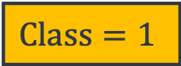
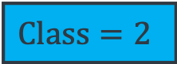
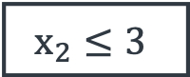
Decision Trees – Numerical Example
Class 1
Class 2
x₂
$$x_{2}≤5$$
Yes
No
9
8
7
6
5
4
3
2
1
$$x_{1}≤4.5$$
C$lass=2$
Yes
No
$$Class=1$$
$$x_{2}≤3$$
5
Yes
No
3
$$Class=2$$
$$Class=1$$
4.5
x₁

Slide 12
Decision Trees – Numerical Example
Class 1
Class 2
x₂
$$x_{2}≤5$$
9
8
7
6
5
4
3
2
1
$$x_{1}≤4.5$$
C$lass=2$
$$Class=1$$
$$x_{2}≤3$$
$$Class=2$$
$$Class=1$$
1 2 3 4 5 6
x₁

Slide 13
Decision Trees - Example
Weather | Demand | Address | ontime
Sunny | High | Correct | No
Sunny | High | Misspelled | No
Overcast | High | Correct | Yes
Rainy | High | Correct | Yes
Rainy | Normal | Correct | Yes
Rainy | Normal | Misspelled | No
Overcast | Normal | Correct | Yes
Sunny | High | Correct | No
Sunny | Normal | Correct | Yes
Rainy | Normal | Misspelled | Yes
Sunny | Normal | Misspelled | Yes
Overcast | High | Misspelled | Yes
Overcast | Normal | Correct | Yes
Rainy | High | Misspelled | No
Given this dataset, let’s predict package delivery timeline (on time/not on time) using a decision tree.

Slide 14
Decision Trees - Example
Weather | Demand | Address | ontime
Sunny | High | Correct | No
Sunny | High | Misspelled | No
Overcast | High | Correct | Yes
Rainy | High | Correct | Yes
Rainy | Normal | Correct | Yes
Rainy | Normal | Misspelled | No
Overcast | Normal | Correct | Yes
Sunny | High | Correct | No
Sunny | Normal | Correct | Yes
Rainy | Normal | Misspelled | Yes
Sunny | Normal | Misspelled | Yes
Overcast | High | Misspelled | Yes
Overcast | Normal | Correct | Yes
Rainy | High | Misspelled | No
Weather
Sunny
Rainy
Overcast
Demand
Address
Yes
High
Normal
Misspelled
Correct
No
Yes
No
Yes

Slide 15
Decision Trees - Example
Weather
Weather
Root Node
How to Learn a Decision Tree?
Sunny
Rainy
Overcast
Address
Demand
Address
Demand
Internal Nodes
Yes
High
Normal
Misspelled
Correct
Leaf or Terminal Nodes
No
Yes
No
Yes

Slide 16
Learn a Decision Tree – ID3 Algorithm
Top down approach: Grow the tree from root node to leaf nodes.
ID3* Algorithm:
Repeat the steps below:
Select “the best feature” to split (we will see how to select)
Separate the training samples according to the selected feature
Stop if we have samples from a single class or if we used all features, and note it as a leaf node
Assign the leaf node the majority class of the samples in it
*ID3 (Iterative Dichotomiser 3)

Slide 17
Best Feature to Split with?
A good split results in overall less uncertainty (impurity). For example:
Not too sure
Weather | Demand | Address | ontime
Sunny | High | Correct | No
Sunny | High | Misspelled | No
Overcast | High | Correct | Yes
Rainy | High | Correct | Yes
Rainy | Normal | Correct | Yes
Rainy | Normal | Misspelled | No
Overcast | Normal | Correct | Yes
Sunny | High | Correct | No
Sunny | Normal | Correct | Yes
Rainy | Normal | Misspelled | Yes
Sunny | Normal | Misspelled | Yes
Overcast | High | Misspelled | Yes
Overcast | Normal | Correct | Yes
Rainy | High | Misspelled | No
[9+, 5-]
Weather
Sunny
Rainy
Overcast
[2+, 3-]
Not too sure
[3+, 2-]
[4+, 0-]
Not too sure
Absolutely sure

Slide 18
Best Feature to Split with?
A good split results in overall less uncertainty (impurity). For example:
Weather | Demand | Address | ontime
Sunny | High | Correct | No
Sunny | High | Misspelled | No
Overcast | High | Correct | Yes
Rainy | High | Correct | Yes
Rainy | Normal | Correct | Yes
Rainy | Normal | Misspelled | No
Overcast | Normal | Correct | Yes
Sunny | High | Correct | No
Sunny | Normal | Correct | Yes
Rainy | Normal | Misspelled | Yes
Sunny | Normal | Misspelled | Yes
Overcast | High | Misspelled | Yes
Overcast | Normal | Correct | Yes
Rainy | High | Misspelled | No
Not too sure
[9+, 5-]
Not too sure
[9+, 5-]
Demand
Address
High
Normal
Correct
Misspelled
[3+, 4-]
[1+, 6-]
[6+, 2-]
[3+, 3-]
Not too sure
Somewhat sure
Somewhat sure
Not too sure

Slide 19
Best Feature to Split with?
What split will results in overall less uncertainty (impurity)?
Not too sure
Not too sure
[9+, 5-]
Not too sure
[9+, 5-]
[9+, 5-]
Weather
Demand
Address
Sunny
Rainy
High
Normal
Correct
Misspelled
Overcast
[2+, 3-]
Not too sure
[3+, 2-]
[3+, 4-]
[1+, 6-]
[6+, 2-]
[3+, 3-]
[4+, 0-]
Not too sure
Absolutely sure
Not too sure
Somewhat sure
Somewhat sure
Not too sure

Slide 20
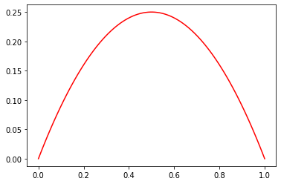
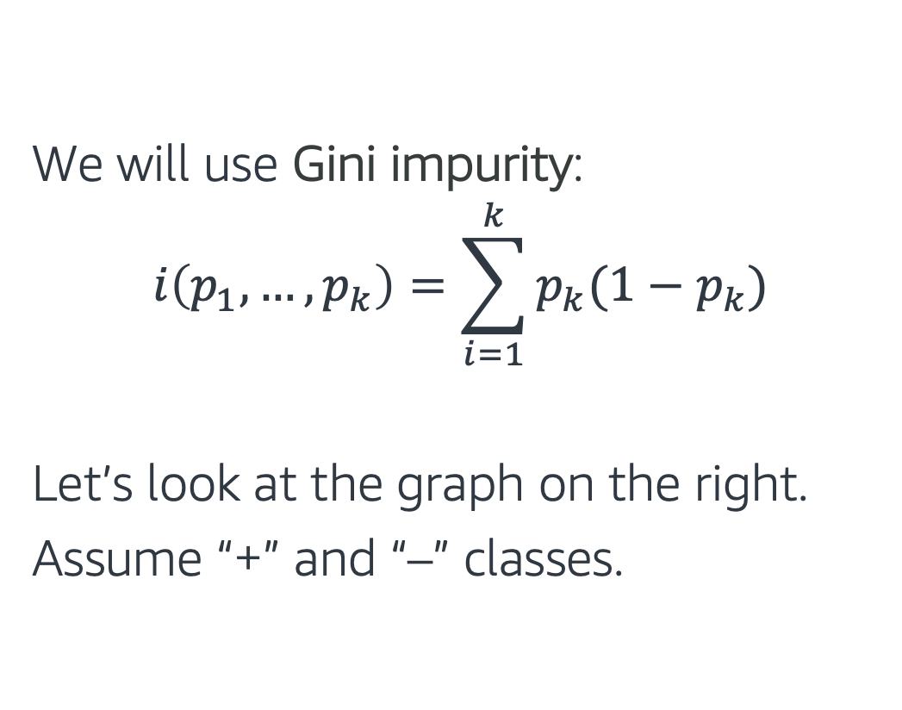
How to Measure Uncertainty
We will use Gini impurity:
$$i\left(p_{1},…,p_{k}\right)=\sum_{i=1}^{k}{p_{k}(1−p_{k})}$$
Let’s look at the graph on the right.
Assume “+” and “–” classes.
Gini Impurity curve
-
-
-
-
+
-
+
+
+
-
-
-
+
-
+
+
+
+
-
-
-
+
+
+

Slide 21
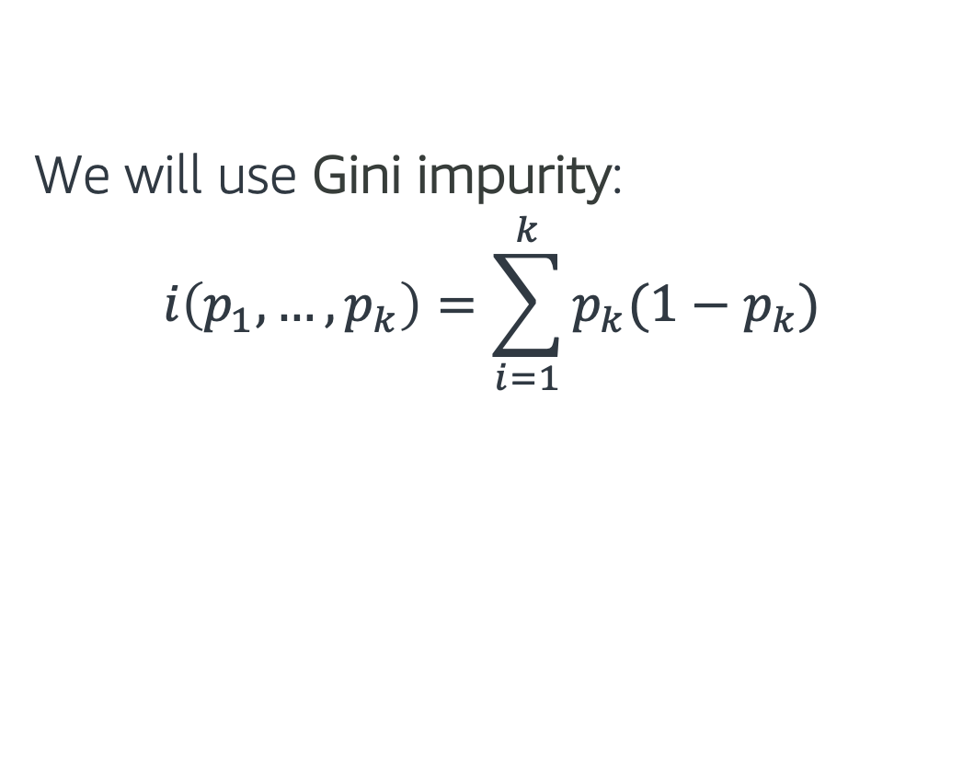
How to Measure Uncertainty
We will use Gini impurity:
$$i\left(p_{1},…,p_{k}\right)=\sum_{i=1}^{k}{p_{k}(1−p_{k})}$$
Gini Impurity curve
If we have only + samples or only – samples:
Low Gini Impurity (low uncertainty)
-
-
-
-
+
-
+
+
+
-
-
-
+
-
+
+
+
+
-
-
-
+
+
+

Slide 22

How to Measure Uncertainty
We will use Gini impurity:
$$i\left(p_{1},…,p_{k}\right)=\sum_{i=1}^{k}{p_{k}(1−p_{k})}$$
Gini Impurity curve
If we have mix of + and - samples:
High Gini Impurity (high uncertainty)
-
-
-
-
+
-
+
+
+
-
-
-
+
-
+
+
+
+
-
-
-
+
+
+

Slide 23
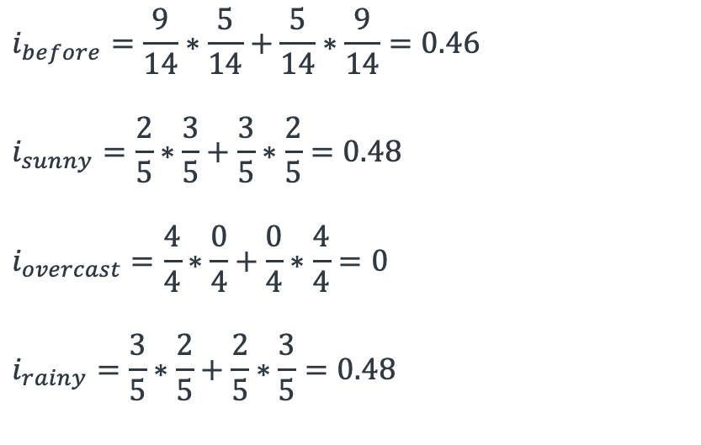
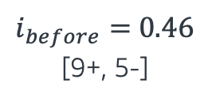
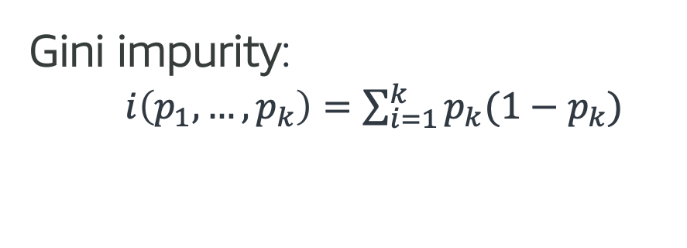
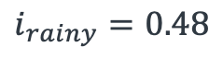
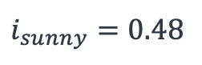
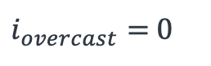
Calculating Gini Impurity
Not too sure
$i_{before}=$0.46
[9+, 5-]
Gini impurity:
$i\left(p_{1},…,p_{k}\right)=\sum_{i=1}^{k}{p_{k}(1−p_{k})}$
Weather
$$i_{before}=\frac{9}{14}∗\frac{5}{14}+\frac{5}{14}∗\frac{9}{14}=0.46$$
$$i_{sunny}=\frac{2}{5}∗\frac{3}{5}+\frac{3}{5}∗\frac{2}{5}=0.48$$
$$i_{overcast}=\frac{4}{4}∗\frac{0}{4}+\frac{0}{4}∗\frac{4}{4}=0$$
$$i_{rainy}=\frac{3}{5}∗\frac{2}{5}+\frac{2}{5}∗\frac{3}{5}=0.48$$
Sunny
Rainy
Overcast
[2+, 3-]
Not too sure
[3+, 2-]
[4+, 0-]
Not too sure
Absolutely sure
$i_{sunny}=$ 0.48
$$i_{rainy}=0.48$$
$i_{overcast}=$0

Slide 24
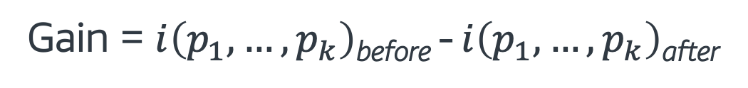
Information Gain & Feature Selection
Information gain: Expected reduction in uncertainty due to selected feature.
“Weather”, “Demand” or “Address”, which one should we select as feature to split?
Gain = $i\left(p_{1},…,p_{k}\right)$_{before} - $i\left(p_{1},…,p_{k}\right)$_{after}
Impurity before split
Impurity after split
[9+, 5-]
[9+, 5-]
[9+, 5-]
Weather
Demand
Address
Sunny
Rainy
Misspelled
Correct
Overcast
High
Normal

Slide 25
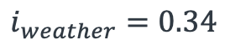
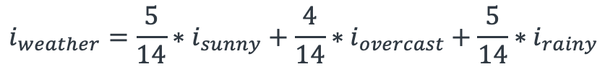
Information Gain & Feature Select
Not too sure
$i_{before}=$0.46
[9+, 5-]
Gini impurity:
$i\left(p_{1},…,p_{k}\right)=\sum_{i=1}^{k}{p_{k}(1−p_{k})}$
Weather
Sunny
Rainy
$$i_{weather}=\frac{5}{14}∗i_{sunny}+\frac{4}{14}∗i_{overcast}+\frac{5}{14}∗i_{rainy}$$
Overcast
[2+, 3-]
Not too sure
[3+, 2-]
(Weighted sum of impurities)
[4+, 0-]
Not too sure
Absolutely sure
$$i_{weather}=0.34$$
$i_{sunny}=$ 0.48
$$i_{rainy}=0.48$$
$i_{overcast}=$0
Gain(“Weather”) = 0.46-0.34=0.12

Slide 26
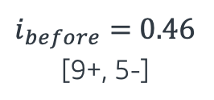
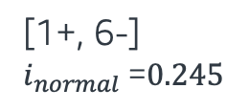
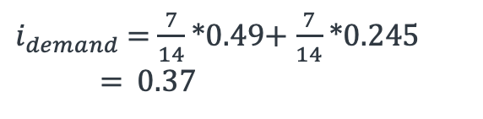
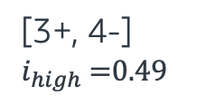
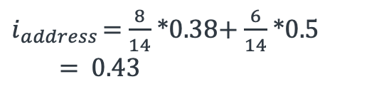
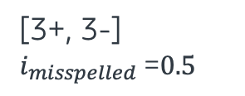
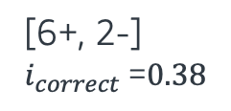
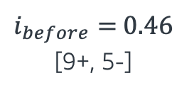
Information Gain & Feature Select
$i_{before}=$0.46
[9+, 5-]
$i_{before}=$0.46
[9+, 5-]
Comparing gains for each feature:
Gain(“Weather”) = 0.46-0.34 = 0.12
Gain(“Demand”) = 0.46-0.37 = 0.09
Gain(“Address”) = 0.46-0.43 = 0.03
“Weather” has the highest gain of all, so we start the tree with the “Weather” feature as the root node!
Demand
Address
High
Normal
Correct
Misspelled
[3+, 4-]
$i_{high}$=0.49
[1+, 6-]
$i_{normal}$=0.245
[6+, 2-]
$i_{correct}$=0.38
[3+, 3-]
$i_{misspelled}$=0.5
$i_{demand}$= $\frac{7}{14}$*0.49+ $\frac{7}{14}$*0.245
= 0.37
$i_{address}$ = $\frac{8}{14}$*0.38+ $\frac{6}{14}$*0.5
= 0.43

Slide 27
Recap ID3 Algorithm
ID3 Algorithm*:
Repeat these steps below:
Select “the best feature” to split using Information Gain
Separate the training samples according to the selected feature
Stop if have samples from a single class or if all features used, and note it as a leaf node
Assign the leaf node the majority class of the samples in it
Weather
Sunny
Rainy
Overcast
Demand
Address
Yes
High
Normal
Misspelled
Correct
No
Yes
No
Yes
* Changes to build a Decision Tree Regressor: 1. Replace the Information Gain with Standard Deviation Reduction. 3. Stop when numerical values are homogeneous (standard deviation is zero) or if used all features, and note it as a leaf node. 4. Assign the leaf node the average value of its samples.

Slide 28
Ensemble Methods - Bagging
Learn multiple models and combine their results, to improve generalization
Bagging (Bootstrap Aggregating) methods
Build several independent estimators on randomly drawn samples from the training set (with replacement)
Majority vote or average the predictions from all estimators
On average, the combined estimator is usually better than any of the single base estimator because its variance is reduced
Bagging Trees: Random Forest

Slide 29
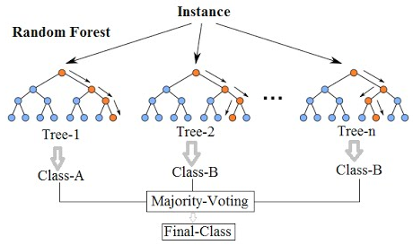
Random Forest
Draw a random bootstrap sample from the training set with replacement.
Grow a decision tree from the bootstrap sample. At each node:
Randomly select features without replacement.
Split the node using the feature that provides the best split (maximizing the information gain)
Repeat 1-2 n times, generating n trees
Aggregate the predictions from all trees to assign the final class.

Slide 30
Ensemble Methods - Boosting
Fit a sequence of weak learners on modified version of original dataset, forcing them to learn from the errors
Boosting methods
Base estimators are built sequentially to reduce the bias of the combined estimator
Boost the performance of a set of easy-to-train weak learners (“stumps”)
Used when the optimal learning model is hard to identify beforehand, or is hard to train computationally
AdaBoost, XGBoost

Slide 31
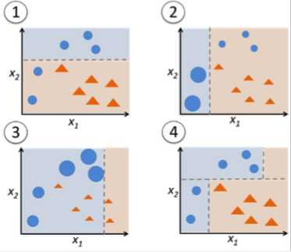
AdaBoost
Initially, all data points weights are set to 1/N, where N is the number of data points:
Trains a weak learner with these weights
Training examples incorrectly predicted have their weights increased, whereas the weights are decreased for those that were predicted correctly
Repeat 1-2
Predictions from all weak learners are then combined through a weighted majority vote (or sum) to produce the final prediction.

Slide 32
Topics for Day 2
Tree-based Models
Regression Models
Optimization
Regularization
Hyperparameter Tuning
AWS AI/ML Services and Model Deployment
Final Project

Slide 33
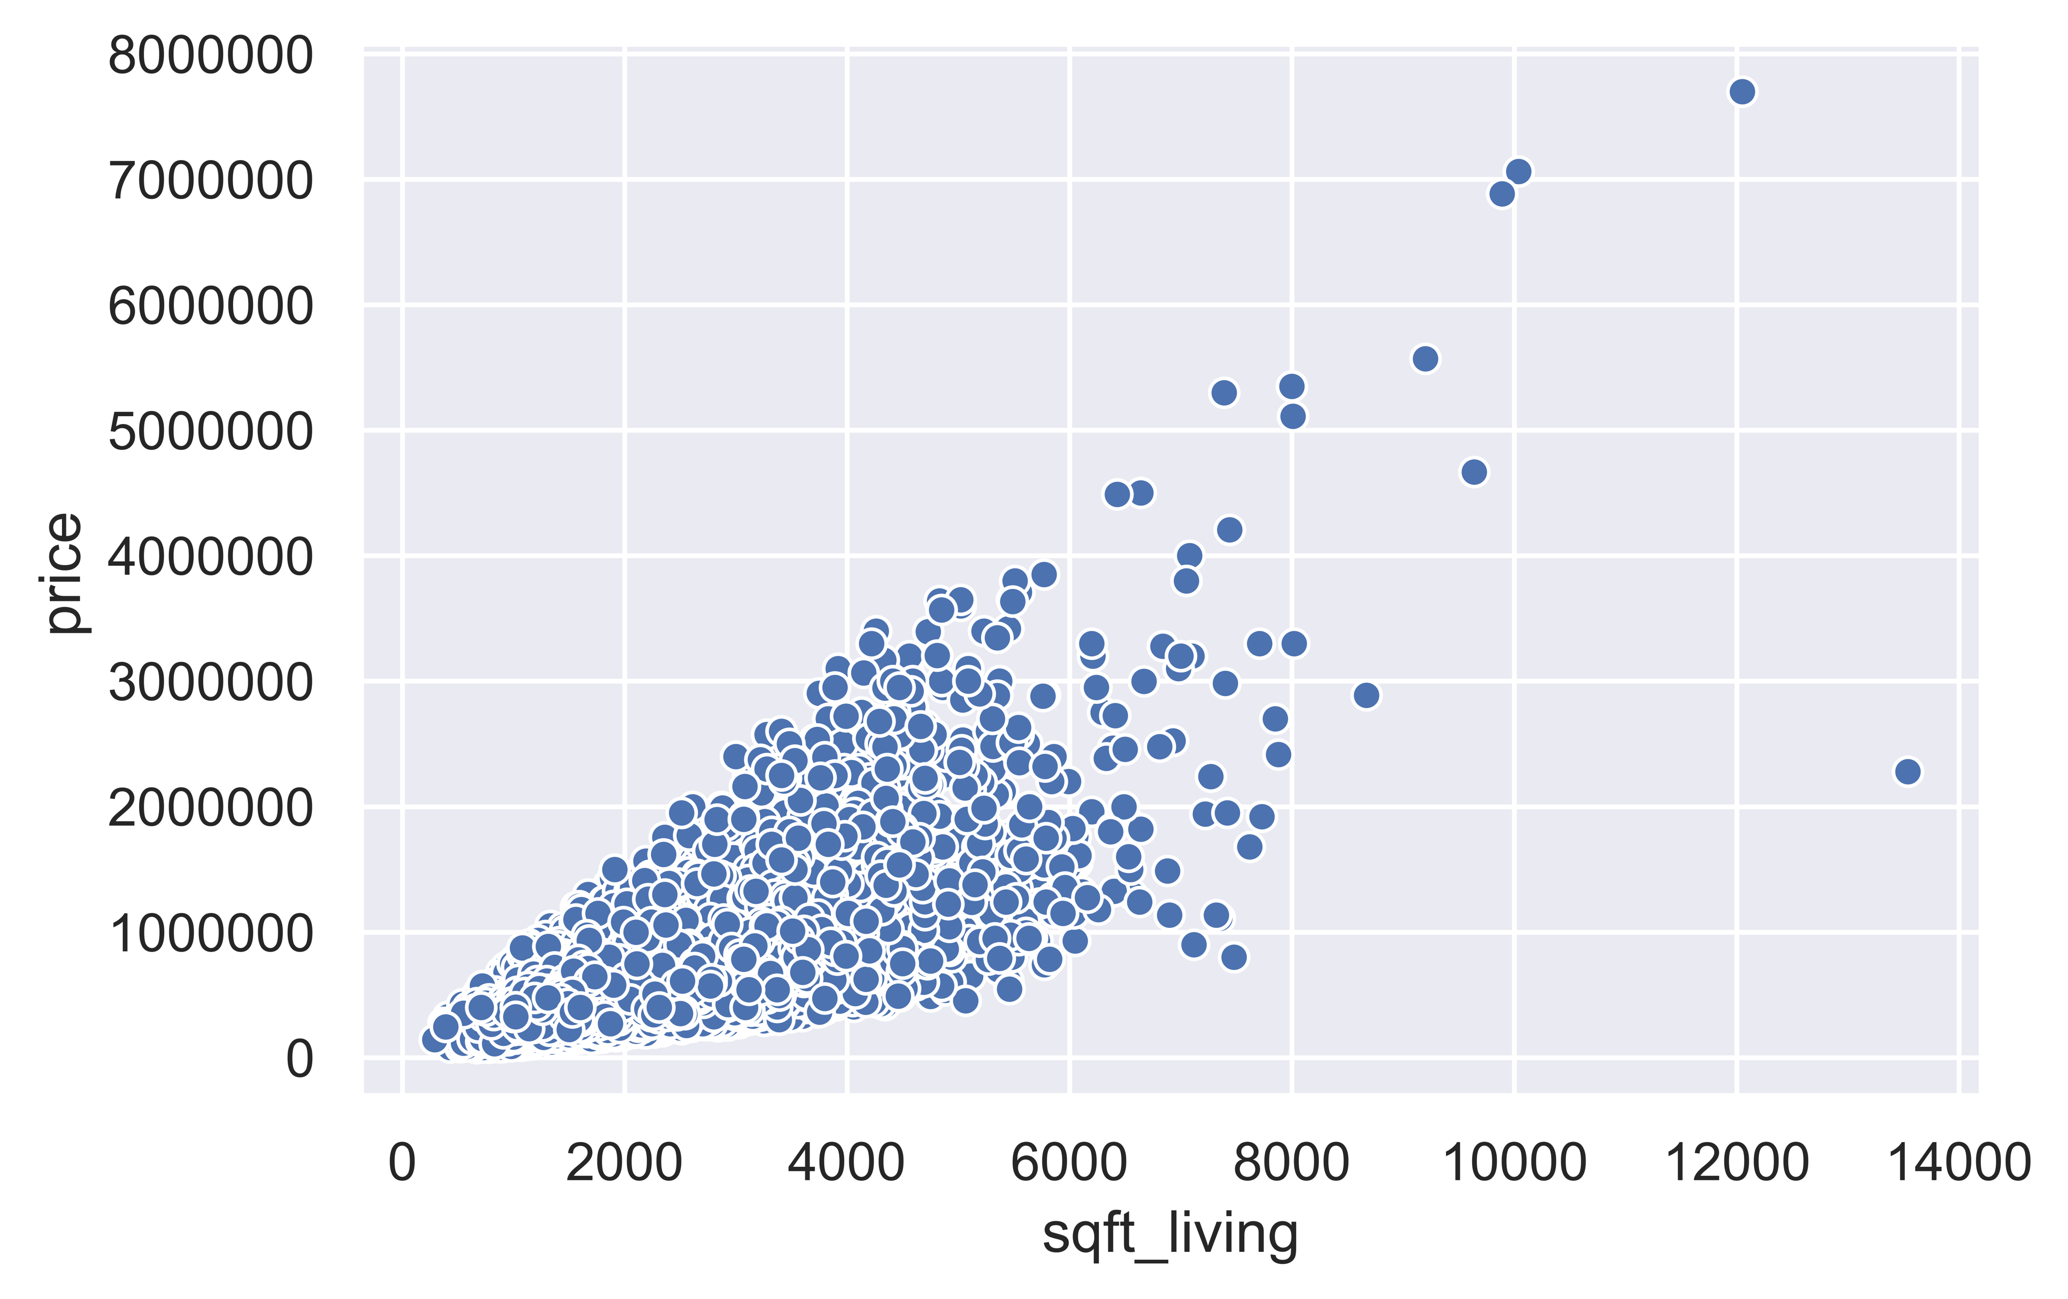
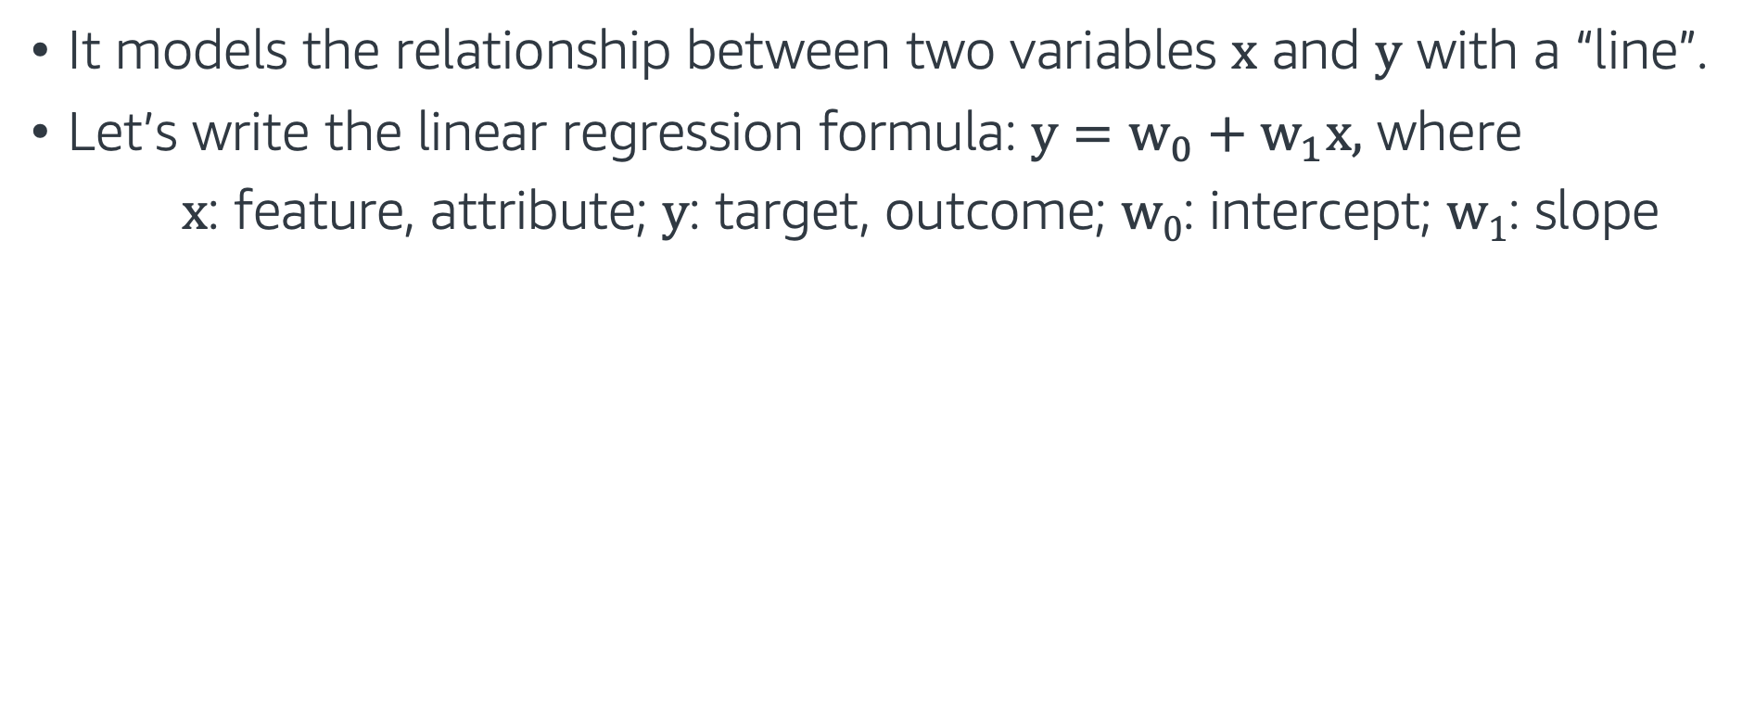
Linear Regression
It models the relationship between two variables x and y with a “line”.
Let’s write the linear regression formula: $y=w_{0}+w_{1}x,$ where
x: feature, attribute; y: target, outcome; w₀: intercept; w₁: slope
Example: How does the price of a house (y) relate to its living square footage (x)?
* Data source: King County, WA Housing Info.

Slide 34
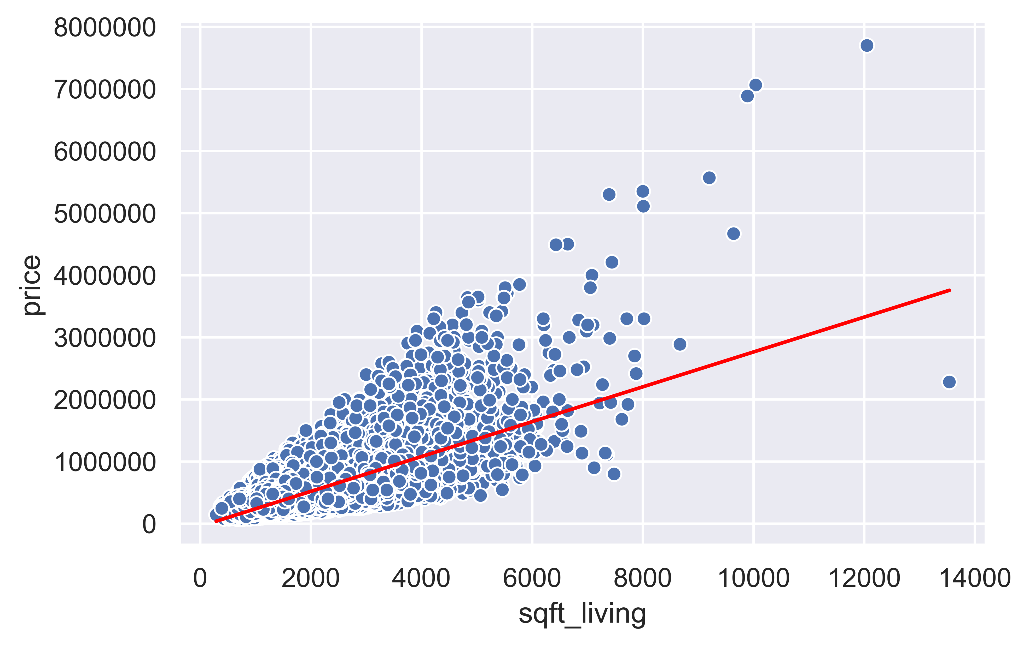
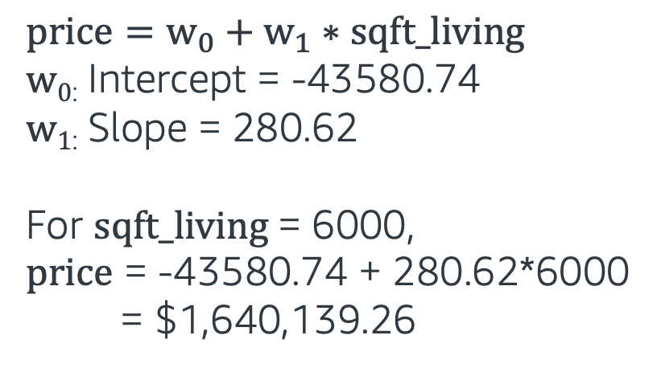
Linear Regression
Linear Regression fits the “best” line to predict the price of a house for a given square footage.
x: sqft_living; y: price; w₀: intercept; w₁: slope
$$price=w_{0}+w_{1}∗sqft_living$$
w_{0:} Intercept = -43580.74
w_{1:} Slope = 280.62
For $sqft_living$= 6000,
$price$ = -43580.74 + 280.62*6000
= $1,640,139.26

Slide 35
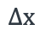
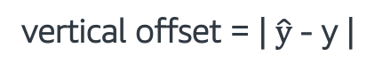
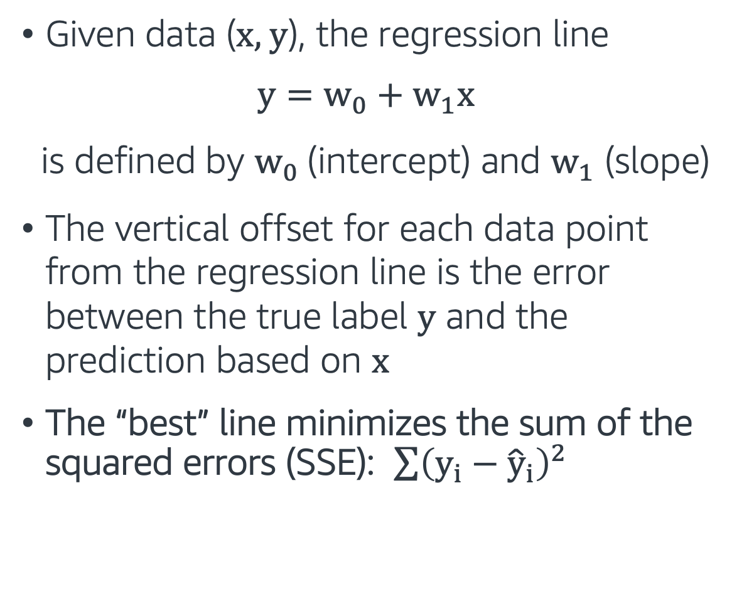
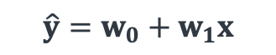
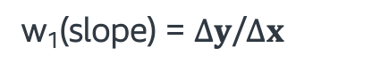
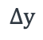
Linear Regression
Given data (x, y), the regression line
$$y=w_{0}+w_{1}x$$
is defined by $w_{0}$(intercept) and $w_{1}$ (slope)
The vertical offset for each data point from the regression line is the error between the true label y and the prediction based on x
The “best” line minimizes the sum of the squared errors (SSE): $\sum{{\left(y_{i}−{\hat{y}}_{i}\right)}^{2}}$
y
vertical offset = | $\hat{y}$- y |
$$\hat{y}=w_{0}+w_{1}x$$
$$∆y$$
$$∆x$$
w₁(slope) = $∆y$/$∆x$
w₀ (Intercept)
x

Slide 36
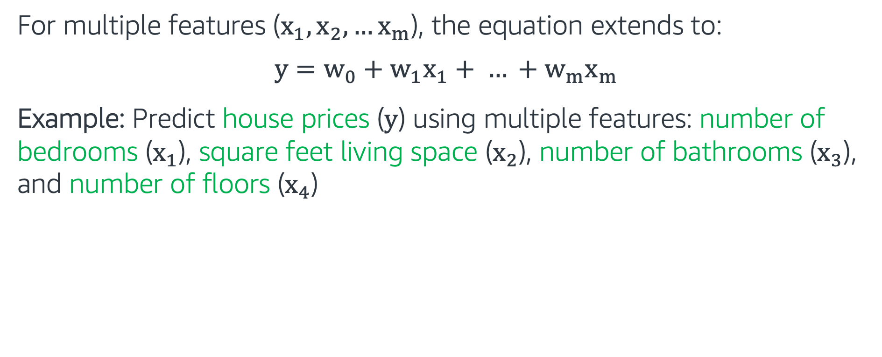
Multiple Linear Regression
For multiple features ($x_{1},x_{2}, …x_{m}$), the equation extends to:
$$y=w_{0}+w_{1}x_{1}+ … +w_{m}x_{m}$$
Example: Predict house prices ($y$) using multiple features: number of bedrooms ($x_{1}$), square feet living space ($x_{2}$), number of bathrooms ($x_{3}$), and number of floors ($x_{4}$)
bedrooms | sqft_living | bathrooms | floors | price ($)
3 | 1180 | 1.00 | 1.0 | 221900.0
3 | 2570 | 2.25 | 2.0 | 538000.0
2 | 770 | 1.00 | 1.0 | 180000.0
4 | 1960 | 3.00 | 1.0 | 604000.0
.. | .. | .. | .. | ..

Slide 37
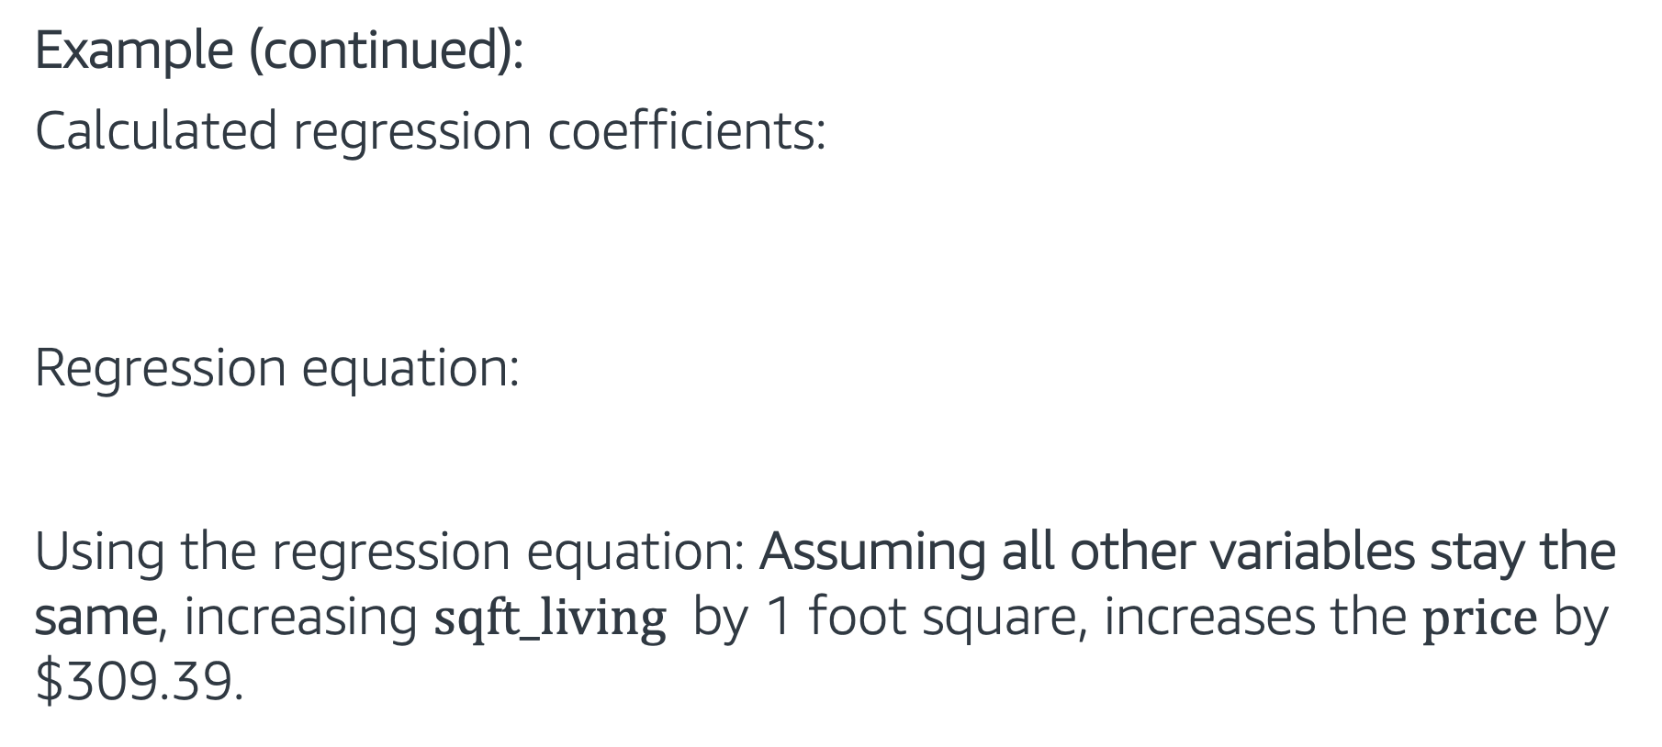
Multiple Linear Regression
Example (continued):
Calculated regression coefficients:
Regression equation:
Using the regression equation: Assuming all other variables stay the same, increasing $sqft_living$ by 1 foot square, increases the $price$ by $$\text{309.39}$.
w₀ (intercept) | w₁ (bedrooms) | w₂ (sqft_living) | w₃ (bathrooms) | w₄ (floors)
74669.67 | -57847.96 | 309.39 | 7853.52 | 200.497
$y=\text{74669.67} \text{−} \text{57847.96} x_{1}+\text{309.39} x_{2}$ $+\text{7853.52} x_{3}+\text{200.497}{ x}_{4}$

Slide 38
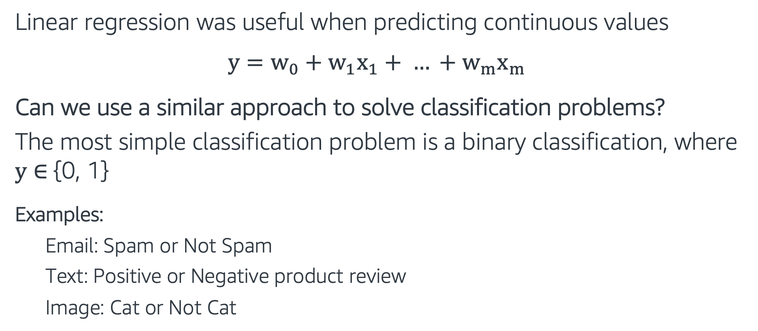
Logistic Regression
Linear regression was useful when predicting continuous values
$$y=w_{0}+w_{1}x_{1}+ … +w_{m}x_{m}$$
Can we use a similar approach to solve classification problems?
The most simple classification problem is a binary classification, where y $∈${0, 1}
Examples:
Email: Spam or Not Spam
Text: Positive or Negative product review
Image: Cat or Not Cat

Slide 39
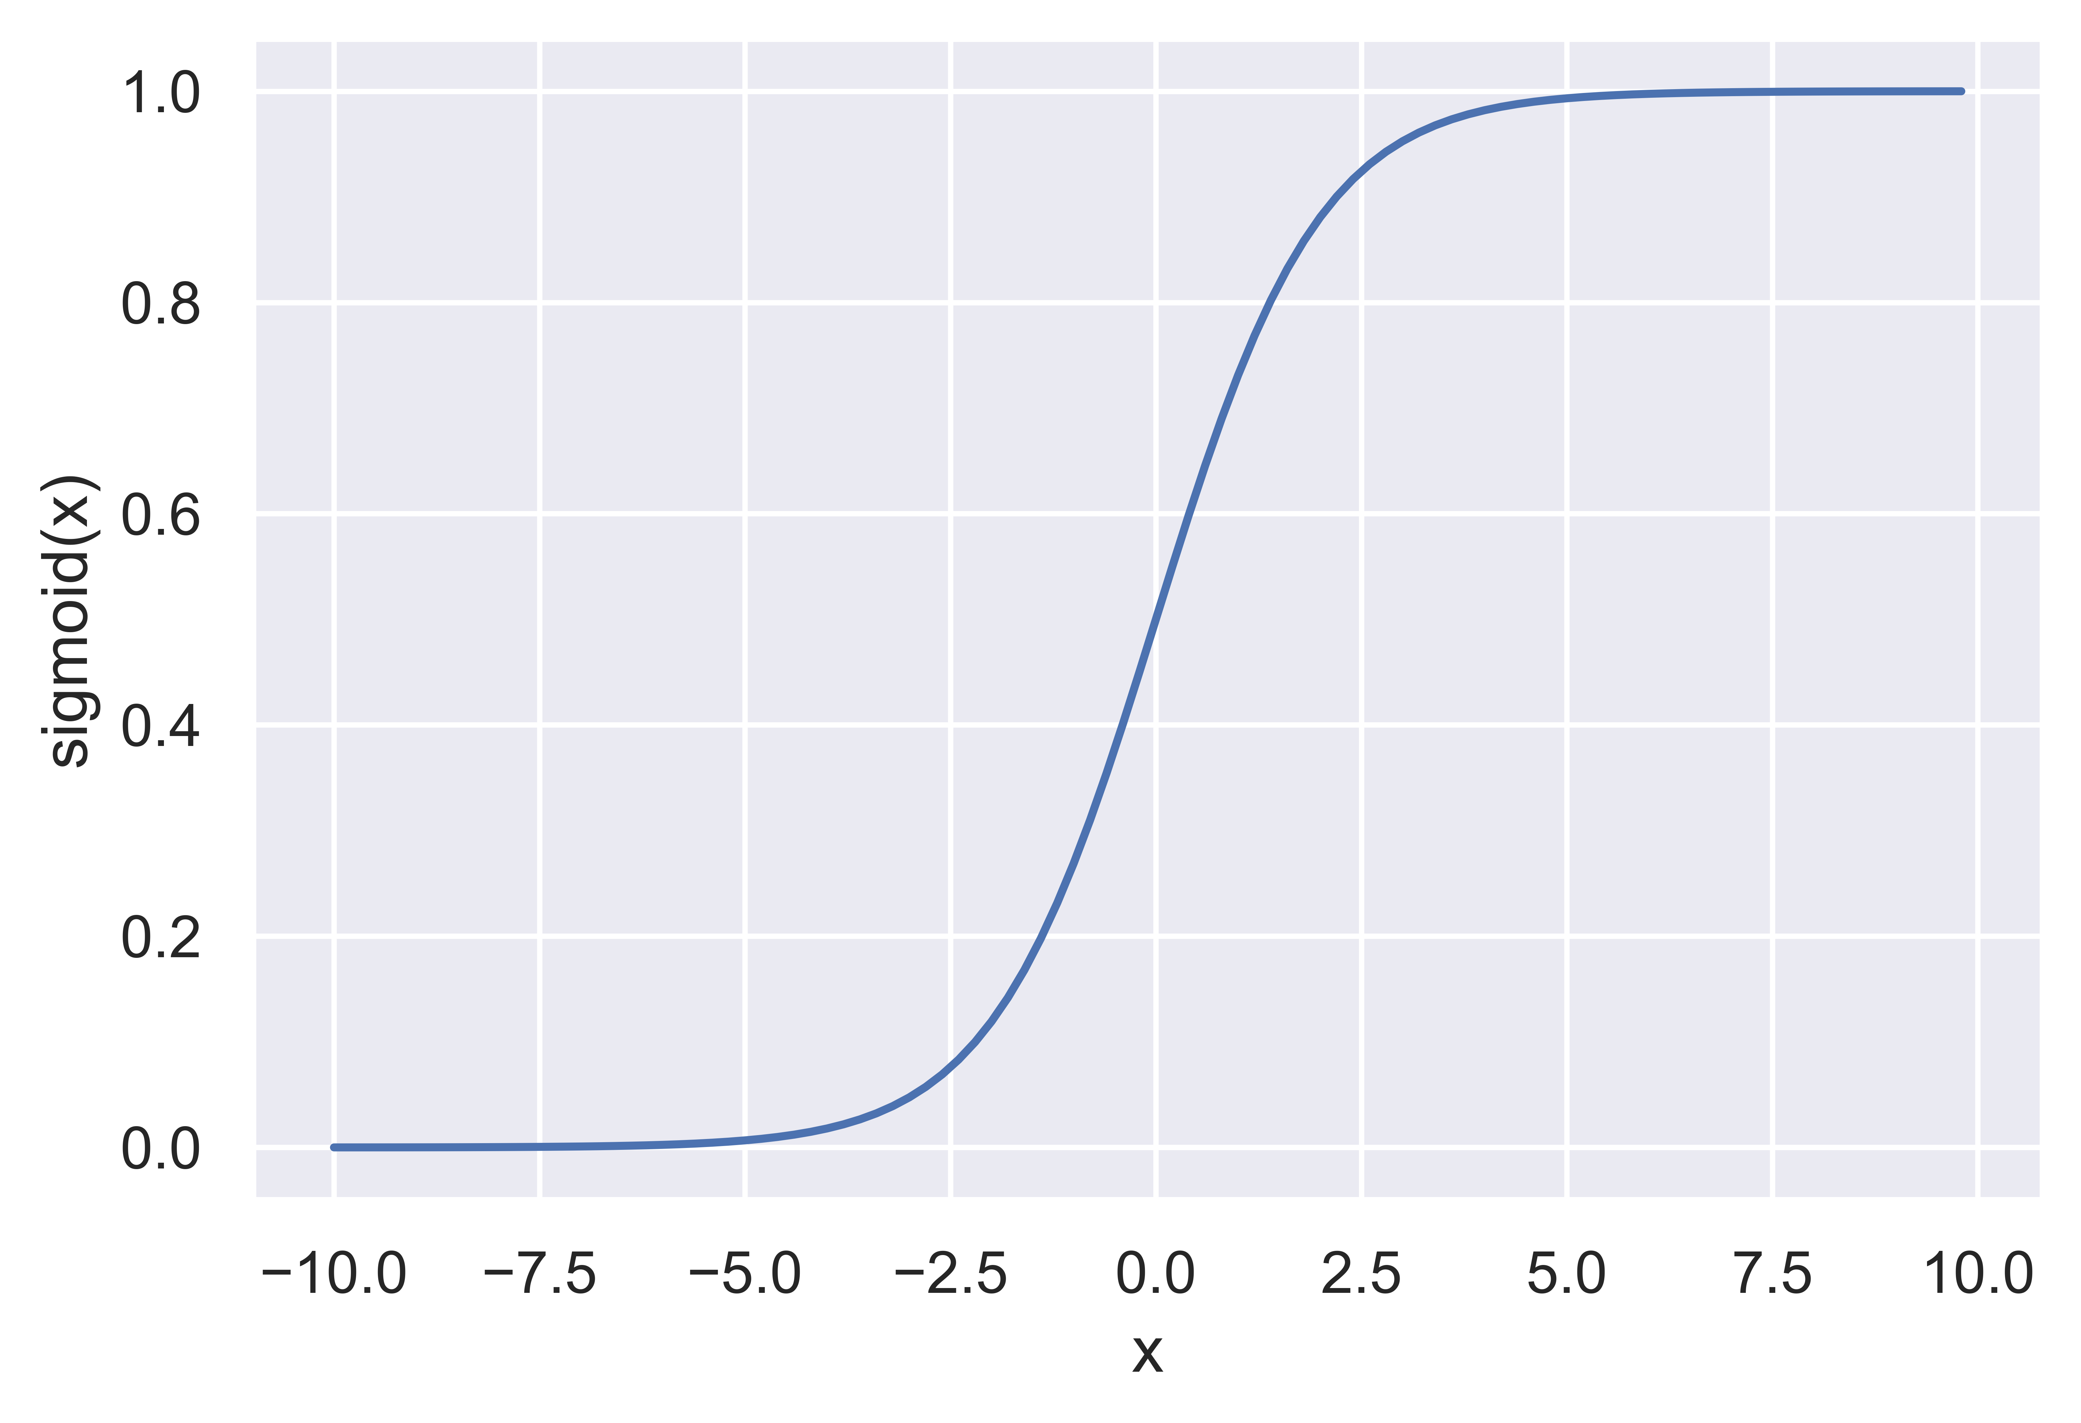
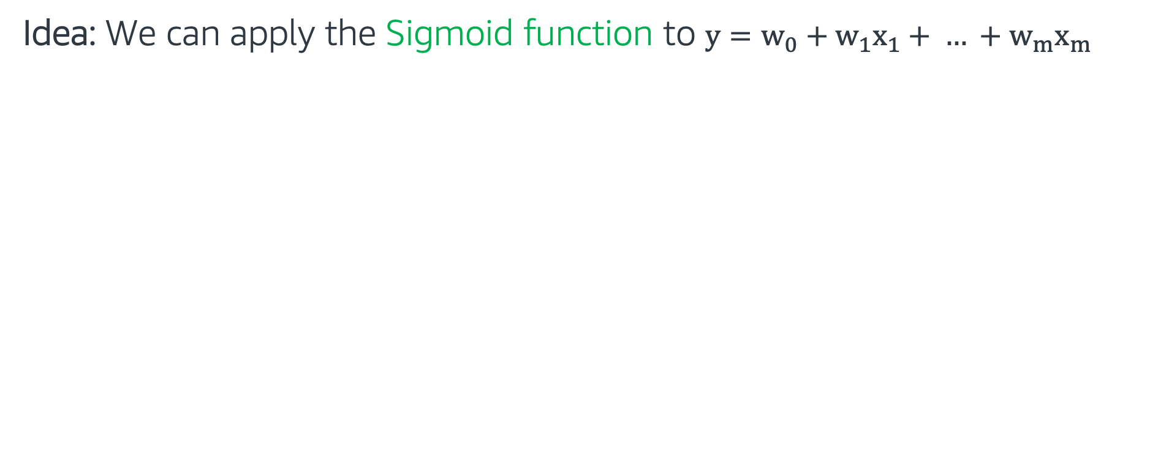
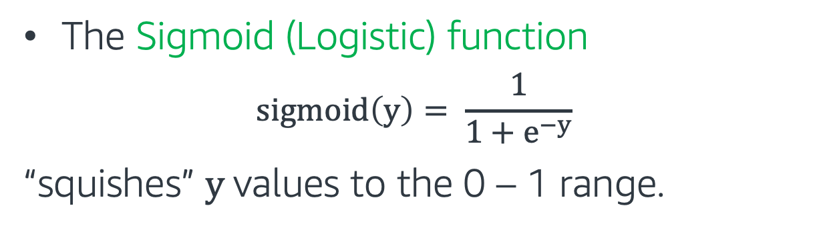
Logistic Regression
Idea: We can apply the Sigmoid function to $y=w_{0}+w_{1}x_{1}+ … +w_{m}x_{m}$
The Sigmoid (Logistic) function
$$sigmoid\left(y\right)= \frac{1}{1+e^{−y}}$$
“squishes” $y$values to the 0 – 1 range.

Slide 40
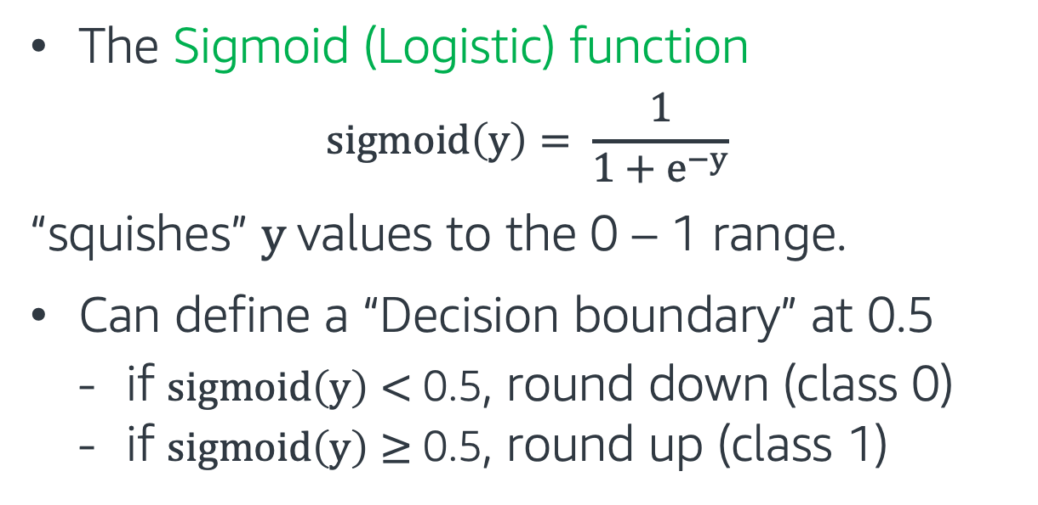
Logistic Regression
Idea: We can apply the Sigmoid function to $y=w_{0}+w_{1}x_{1}+ … +w_{m}x_{m}$
The Sigmoid (Logistic) function
$$sigmoid\left(y\right)= \frac{1}{1+e^{−y}}$$
“squishes” $y$values to the 0 – 1 range.
Can define a “Decision boundary” at 0.5
if $sigmoid\left(y\right)<$ 0.5, round down (class 0)
if $sigmoid\left(y\right)≥$ 0.5, round up (class 1)

Slide 41
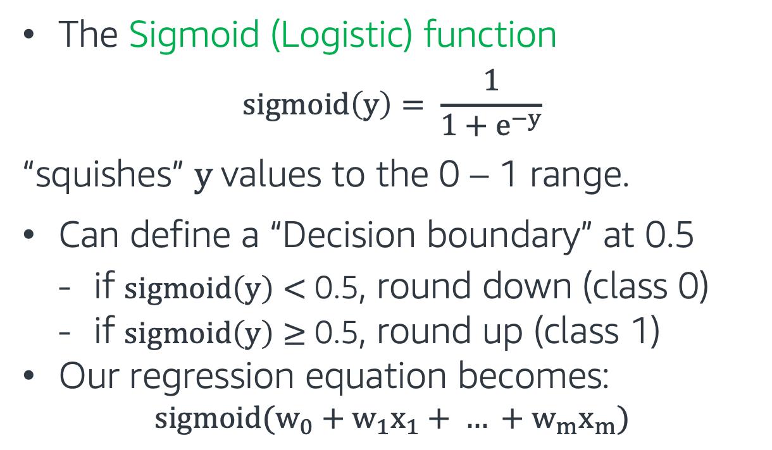
Logistic Regression
Idea: We can apply the Sigmoid function to $y=w_{0}+w_{1}x_{1}+ … +w_{m}x_{m}$
The Sigmoid (Logistic) function
$$sigmoid\left(y\right)= \frac{1}{1+e^{−y}}$$
“squishes” $y$values to the 0 – 1 range.
Can define a “Decision boundary” at 0.5
if $sigmoid\left(y\right)<$ 0.5, round down (class 0)
if $sigmoid\left(y\right)≥$ 0.5, round up (class 1)
Our regression equation becomes:
$$sigmoid(w_{0}+w_{1}x_{1}+ … +w_{m}x_{m})$$

Slide 42
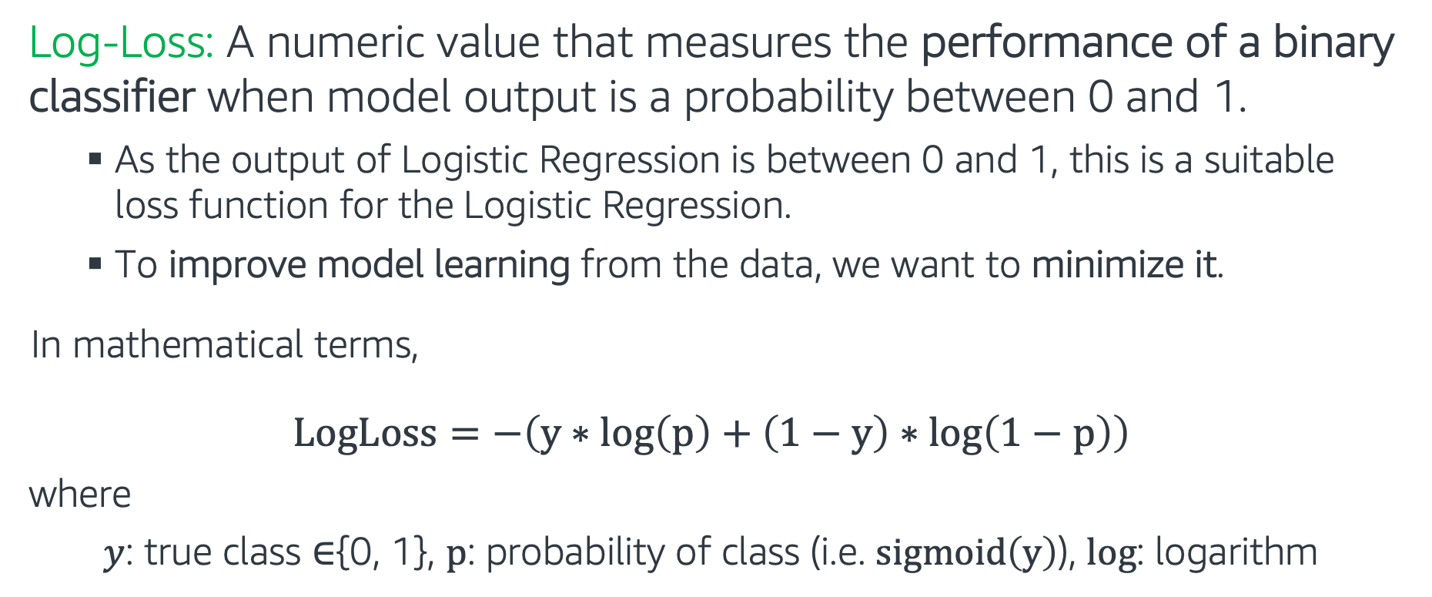
Log-loss (Binary Cross-Entropy)
Log-Loss: A numeric value that measures the performance of a binary classifier when model output is a probability between 0 and 1.
As the output of Logistic Regression is between 0 and 1, this is a suitable loss function for the Logistic Regression.
To improve model learning from the data, we want to minimize it.
In mathematical terms,
$$LogLoss=−\left(y∗log\left(p\right)+\left(1−y\right)∗\log\left(1−p\right)\right)$$
where
$y$: true class $∈${0, 1}, p: probability of class (i.e. $sigmoid\left(y\right)$), log: logarithm

Slide 43


Log-loss (Binary Cross-Entropy)
Example: Let’s calculate the Log-Loss
for the following scenarios:
$y$: true class $=1,$p = 0.3
$y$: true class $=1,$p = 0.8
$$LogLoss=−\left(y∗log\left(p\right)+\left(1−y\right)∗\log\left(1−p\right)\right)$$
LogLoss when y=1

Slide 44
Log-loss (Binary Cross-Entropy)
Example: Let’s calculate the Log-Loss
for the following scenarios:
$y$: true class $=1,$p = 0.3
$y$: true class $=1,$p = 0.8
$$LogLoss=−\left(y∗log\left(p\right)+\left(1−y\right)∗\log\left(1−p\right)\right)$$
LogLoss when y=1
$$−(1∗log\left(0.3\right)+\left(1−1\right)∗\log\left(0.7\right))=0.52$$
$$−(1∗log\left(0.8\right)+\left(1−1\right)∗\log\left(0.2\right))=0.1$$

Slide 45
Log-loss (Binary Cross-Entropy)
Example: Let’s calculate the Log-Loss
for the following scenarios:
$y$: true class $=1,$p = 0.3
$y$: true class $=1,$p = 0.8
$$LogLoss=−\left(y∗log\left(p\right)+\left(1−y\right)∗\log\left(1−p\right)\right)$$
LogLoss when y=1
$$−(1∗log\left(0.3\right)+\left(1−1\right)∗\log\left(0.7\right))=0.52$$
$$−(1∗log\left(0.8\right)+\left(1−1\right)∗\log\left(0.2\right))=0.1$$
p=0.3
p=0.8
Better prediction gives smaller loss

Slide 46
Logistic Regression - Hands on
In this exercise, we work with our final project datasets, training a classifier to predict the isPositive field for the test dataset
The exercise covers the following topics:
ML Model: Logistic Regression
Model Evaluation: Probability Threshold Calibration
Follow through this notebook: “EMBK-NLP-DAY2-LOGREGR-NB.ipynb”

Slide 47
Topics for Day 2
Tree-based Models
Regression Models
Optimization
Regularization
Hyperparameter Tuning
AWS AI/ML Services and Model Deployment
Final Project

Slide 48

Gradient Descent
One of the important part of supervised learning algorithms is to define an objective function C(w) to optimize, where w refers to the weights or the coefficients of the model.
In the case of Linear and Logistic Regression:
Linear regression (Squared Error): $C\left(w\right)=\sum{{\left(y_{i}−{\hat{y}}_{i}\right)}^{2}}$
Logistic regression (LogLoss): $C\left(w\right)=\sum{−(y_{i}∗\log\left(p_{i}\right)+\left(1−y_{i}\right)∗\log\left(1−p_{i}\right))}$
Gradient descent searches for the weights (‘the model’) that minimize the cost function.

Slide 49


Gradient Descent
Gradient Descent finds the minimum of a cost function by moving in the direction of the steepest descent iteratively. At each iteration, weights are updated by:
$$w≔w+∆w$$
where the weight update $∆w$ is the multiplication of the learning rate $η$, and the negative gradient:
$$∆w=−η∆C(w)$$
The gradient is given by the derivative of the cost function with respect to the weight:
$$∆C\left(w\right)=\frac{∂C(w)}{∂w}$$
C(w)
w

Slide 50
Topics for Day 2
Tree-based Models
Regression Models
Optimization
Regularization
Hyperparameter Tuning
AWS AI/ML Services and Model Deployment
Final Project

Slide 51
Regularization
y
Underfitting
Underfitting: Model too simple, fewer features, smaller weights, weak learning.
Overfitting: Model too complex, too many features, larger weights, weak generalization.
‘Just Right’ Model: Compromise between fit (that is, learning, minimizing a cost function) and complexity (drop features and/or reduce weights).
x
y
Overfitting
x
y
‘Just Right’ Model
Regularization does both: penalizes large weights, sometimes all the way to zero!
x

Slide 52

Regularization
Tune model complexity by adding a penalty score for complexity to the cost function
$C_{regularized}\left(w\right)=C\left(w\right)$ + $α∗penalty$(w)
Calibrate regularization strength by using a regularizer parameter, $α$
Standard regularization types:
L2 regularization (Ridge): $penalty(w)={\left\|w\right\|}_{2}^{2}=\sum{w_{i}^{2}}$ (L2: popular choice)
L1 regularization (LASSO): $penalty(w)={\left\|w\right\|}_{1}=\sum{\left|w_{i}\right|}$
Both L2 and L1 (ElasticNet)
(L1: useful as feature selection, since most weights shrink to 0 - sparsity)
Note: Important to scale features first!

Slide 53
Linear Regression - Hands on
In this exercise, we work with our review dataset (which is very similar to our final project dataset) to predict the log_votes field
The exercise covers the following topics:
ML Model: Linear Regression
Regularization: L1 (LASSO), L2 (Ridge), and Elastic Net
Follow through this notebook: “EMBK-NLP-DAY2-LINREGR-NB.ipynb”

Slide 54
Topics for Day 2
Tree-based Models
Regression Models
Optimization
Regularization
Hyperparameter Tuning
AWS AI/ML Services and Model Deployment
Final Project

Slide 55
Hyperparameter Tuning
Hyperparameters are parameters that affect the performance and structure of an ML algorithm.
Hyperparameter tuning looks for the best combination of hyperparameters.
For example:
K Nearest Neighbors: n_neighbors, metric
Decision trees: max_depth, min_samples_leaf, class_weight, criterion
Random Forest: n_estimators, max_samples
Logistic Regression: penalty, C, class_weight, l1_ratio

Slide 56
Grid Search
Grid search is the most basic hyperparameter tuning method.
It is an exhaustive search to find the optimum combination of hyperparameters.
Example: Hyperparameters for a Decision tree:
{
max_depth: [5, 10, 50, 100, 250],
min_samples_leaf: [15, 20, 25],
criterion: [“gini”, “entropy”]
}
Total hyperparameters combinations 5 x 3 x 2 = 30:
[5, 15, “gini”]
[5, 20, “gini”]
[5, 25, “gini”]
….

Slide 57
Randomized Search
Instead of trying every possible combination, Randomized Search chooses a random set of values and only try those.
Randomized search can also use distributions to sample hyperparameters from.
Grid Search
Randomized Search
Hyperparameter 2
Hyperparameter 2
Hyperparameter 1
Hyperparameter 1

Slide 58
Cross-Validation
Cross Validation is a validation technique to see how well a trained model generalizes to an independent test set.
Hold-out method: We keep a hold-out sample and use it to test the model (single hold-out sample).
K-fold cross-validation: Use “K” hold-out samples to train the model “K” times without using the hold-out samples (multiple hold-outs)

Slide 59
5-fold Cross-Validation - Example
(1st fold)
Set aside 1/5 of the data as hold-out.
Train the model with the training set.
Test the model on the hold-out and record model performance.
(2nd fold)
4. Set aside the next hold-out.
5. Repeat 1-3 until each record is used in the hold-out portion. (5 times in total)
…
6. Average or combine the model performance metrics.
1st fold
hold-out
training set
2nd fold
training
set
hold-out
training set
3rd fold
training set
hold-out
training set
4th fold
training set
hold-out
training
set
5th fold
training set
hold-out

Slide 60
Putting it all together - Hands on
In this exercise, we continue to work with our review dataset (very similar to our final project dataset) to predict the log_votes field
The exercise covers the following topics:
ML Models: Decision Tree Regressor, Random Forest Regressor
Hyperparameter Tuning and Cross-Validation
Follow through this notebook: “EMBK-NLP-DAY2-TREE-NB.ipynb”

Slide 61
Topics for Day 2
Tree-based Models
Regression Models
Optimization
Regularization
Hyperparameter Tuning
AWS AI/ML Services and Model Deployment
Final Project

Slide 62
AWS Comprehend
Comprehend is a Natural Language Processing AWS service that allows users to extract insights from text data and build ML models.
In this section, we will implement a custom text classifier using AWS Comprehend.
Main steps:
1. Creating the classifier
2. Putting data into correct format.
3. Training
4. Make predictions (inference)

Slide 63

Custom Classification

Slide 64

Train classifier
Select “train classifier” under custom classification.
We will enter the name and select the classifier mode.
Let’s use the multi-class mode. Each line is a text and can belong to a single class.

Slide 65

Input data format
Training data is provided in a CSV file (comp_final_training.csv).
First column is the class and second column is the text we will use.
It will be uploaded to a S3 Bucket.

Slide 66

Train classifier
S3 paths for data and output folders are entered.
Create an access permission for training

Slide 67


Create an Analysis Job

Slide 68

Test data
Test data is provided in a CSV file (comp_final_test.csv).
Single column for text data
It will be uploaded to a S3 Bucket.

Slide 69


Create an Analysis Job

Slide 70

Output of the Analysis Job
Once the analysis completed, the status will turn to “Completed”. Click on the classifier under its name
Output files are saved in the link below.

Slide 71

Predictions
Extract the output files and get the json file: predictions.json

Slide 72

AWS SageMaker
SageMaker is an AWS service to easily train, test and deploy ML models: https://aws.amazon.com/sagemaker/
Follow through this notebook to see how to use SageMaker on our review dataset to predict the log_votes field: EMBK-NLP-DAY2-SAGEMAKER-NB.ipynb
Hyperparameters Tuning Optimization (HPO)

Slide 73
Topics for Day 2
Tree-based Models
Regression Models
Optimization
Regularization
Hyperparameter Tuning
AWS AI/ML Services and Model Deployment
Final Project

Slide 74

Final Project – Sentiment Analysis
Data: Customer reviews. Let's look at first 5 rows of the training dataset:
Task: Train a classifier to predict the isPositive field for the test dataset.
Follow through this notebook ”EMBK-NLP-DAY2-FINAL-STUDENT-NB.ipynb” to start on the final project.

Slide 75
Notebooks for Day 2
EMBK-NLP-DAY2-LOGREGR-NB.ipynb: Logistic Regression
EMBK-NLP-DAY2-LINREGR-NB.ipynb: Linear Regression and Regularization
EMBK-NLP-DAY2-TREE-NB.ipynb: Tree-based Models, Hyperparameter Tuning and Cross Validation
EMBK-NLP-DAY2-SAGEMAKER-NB.ipynb: AWS SageMaker LinearLearner
EMBK-NLP-DAY2-FINAL-STUDENT-NB.ipynb: Final Project Walkthrough for Day 2
EMBK-NLP-DAY2-FINAL-SOLUTION-NB.ipynb: Final Project Solution for Day 2

Slide 76
Looking Ahead - Day 3
Neural Networks (NN)
Word Embeddings
Recurrent Neural Networks (RNN)
Long Short-Term Memory (LSTM)
Transformers

